Slide 1
DECISION SUPPORT SYSTEM (DSS) Multi-criteria Decision Making
TEACHING TEAM
DECISION SUPPORT SYSTEM COURSE IN 24/25

Slide 2
What is Multi-criteria Decision Making (MCDM)?
MADM
TERKADANG DIMAKNAI SAMA
Multi-attributes Decision Making
Problems with the scope of discrete decisions Single purpose Predefined alternatives
MCDM
MODM
It is a scientific branch of operations research that intersects with decision-making based on many criteria Determine the best alternative from a number of alternatives based on certain criteria
Multi-objectives Decision Making
Problems with the scope of continuous decisions Multiple goals Alternatives are infinite, because there is an alternative design process in it Alternatives are based on specific goals and procedures
Notes:
MADM menyeleksi alternatif terbaik dari sejumlah alternatif sedangkan MODM merancang alternatif terbaik.
Contoh MADM -> making preference, pemilihan juara dkk (satu tujuan)
Contoh MODM -> perusahaan mobil ingin membuat mobil yang nyaman, irit bbm, biaya produksi murah

Slide 3
MCDM Classification
MCDM
MADM
MODM
Evaluating
Weighting
Normalization
Multi-attributes Utility Analysis
Goal Programming
Genetic Algorithm (GA) dan Neural Network (NN)
DEMATEL, ISM, SEM
ANP, AHP, NN Weighting
Additive
Non-Additive
TOPSIS, SAW, ELECTREE, PROMETHEE, VIKOR
Fuzzy, NN

Slide 4
Concepts in MCDM (1)
Alternative
Multi Criteria
Attribute Conflict / Attribute Type
Choice to be chosen by decision makers
Criteria used to determine which alternatives to choose Can be arranged in the form of a hierarchy (AHP)
Attributes in MCDM are very likely to represent different dimensions, their values have opposite meanings. So, there are 2 types of attributes in MCDM,
Cost, and
Benefit

Slide 5
Concepts in MCDM (2)
Different Criteria
Weight of Results
Decision Matrix
The criteria in the MCDM case are very possible to have different units
Most methods in MCDM use weights to determine the level of importance of the criteria
MCDM uses a decision matrix to represent the relationship between the alternatives and the criteria used
Example: Expense → Rupiah; Distance → Kilometer

Slide 6
Decision Matrix
 | C₁ | C₂ | … | C_{n}
Alternative | (w₁ | w₂ | … | w_{n})
A₁ | r₁₁ | r₁₁ |  | r_{1n}
A₂ | r₂₁ | r₂₂ | … | r_{2n}
. | . | . | … | …
. | . | . | … | …
. | . | . | … | …
A_{m} | A_{m1} | A_{m2} | … | A_{mn}
C → Criteria
A → Alternative
r → The i-th alternative value in the j-th criterion

Slide 7
Decision Making Steps at MADM
Understand the problem and the purpose of decision-making
Determining alternatives (A_{1…}A_{m})
Define criteria(C₁…C_{n})
Determining the value of each criterion for each alternative
Normalize the value of each criterion for each alternative
Determining the weight of each criterion(w₁…w_{n})
Calculate alternative values
Sensitivity test

Slide 8
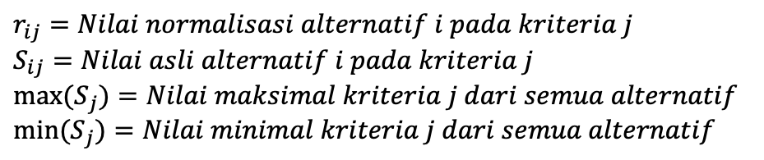
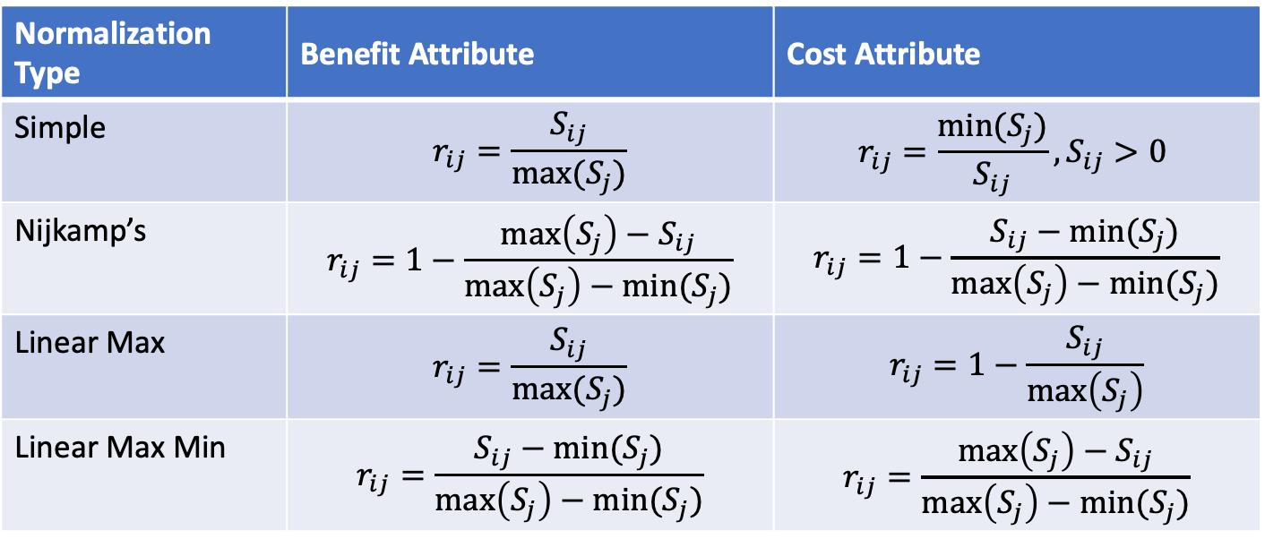
Normalization Techniques (1)
Normalization Type | Benefit Attribute | Cost Attribute
Simple | $$r_{ij}=\frac{S_{ij}}{max⁡(S_{j})}$$ | $$r_{ij}=\frac{min⁡(S_{j})}{S_{ij}}, S_{ij}>0$$
Nijkamp’s | $$r_{ij}=1−\frac{\max\left(S_{j}\right)−S_{ij}}{\max\left(S_{j}\right)−min⁡(S_{j})}$$ | $$r_{ij}=1−\frac{S_{ij}−min⁡(S_{j})}{\max\left(S_{j}\right)−min⁡(S_{j})}$$
Linear Max | $$r_{ij}=\frac{S_{ij}}{max⁡(S_{j})}$$ | $$r_{ij}=1−\frac{S_{ij}}{\max\left(S_{j}\right)}$$
Linear Max Min | $$r_{ij}=\frac{S_{ij}−min⁡(S_{j})}{\max\left(S_{j}\right)−min⁡(S_{j})}$$ | $$r_{ij}=\frac{\max\left(S_{j}\right)−S_{ij}}{\max\left(S_{j}\right)−min⁡(S_{j})}$$
$$r_{ij}=Nilai normalisasi alternatif i pada kriteria j$$
$$S_{ij}=Nilai asli alternatif i pada kriteria j$$
$${max⁡(S}_{j})=Nilai maksimal kriteria j dari semua alternatif$$
$${min⁡(S}_{j})=Nilai minimal kriteria j dari semua alternatif$$

Slide 9
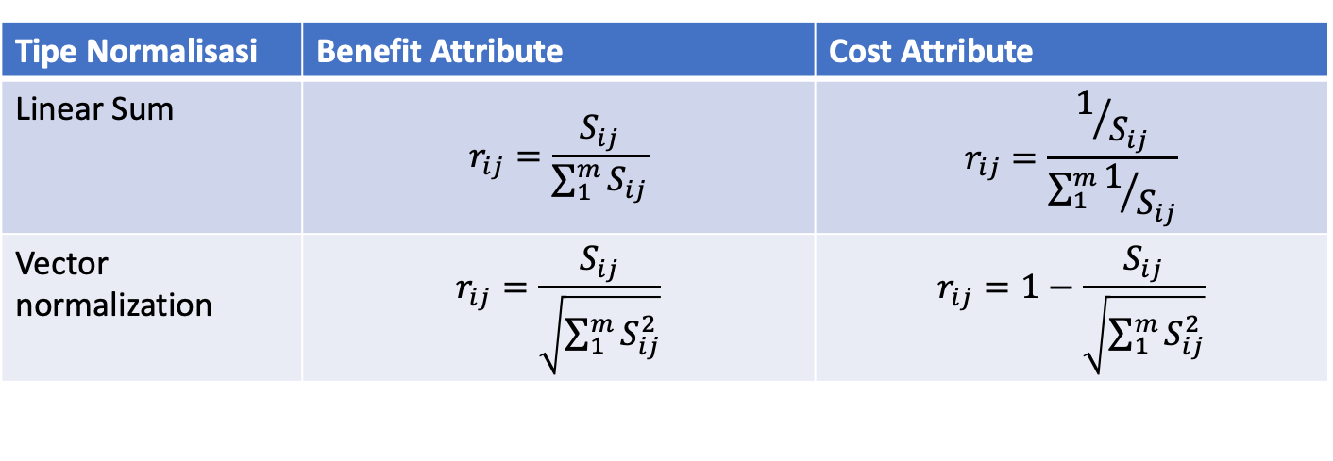
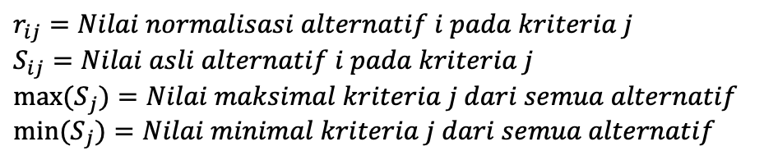
Normalization Techniques (2)
Normalization Type | Benefit Attribute | Cost Attribute
Linear Sum | $$r_{ij}=\frac{S_{ij}}{\sum_{1}^{m}{S_{ij}}}$$ | $$r_{ij}=\frac{1/{S_{ij}}}{\sum_{1}^{m}{1/{S_{ij}}}}$$
Vector normalization | $$r_{ij}=\frac{S_{ij}}{\sqrt{\sum_{1}^{m}{S_{ij}^{2}}}}$$ | $$r_{ij}=1−\frac{S_{ij}}{\sqrt{\sum_{1}^{m}{S_{ij}^{2}}}}$$
$$r_{ij}=Nilai normalisasi alternatif i pada kriteria j$$
$$S_{ij}=Nilai asli alternatif i pada kriteria j$$
$${max⁡(S}_{j})=Nilai maksimal kriteria j dari semua alternatif$$
$${min⁡(S}_{j})=Nilai minimal kriteria j dari semua alternatif$$

